Slide 1
Logic Programming Approach to
Partial-Satisfaction Planning
Tuan A. Nguyen
CSE494/598 Course Project

Slide 2
What is my project?
My research area: AI Planning.
Answer Set Programming (ASP) can be used to encode planning problem.
Smodels supports weight literals.
  ASP-based optimal cost planning.
I extend ASP encoding for optimal cost planning to partial satisfaction planning problem.
  And prove the corresponding between optimal stable model and optimal plan.

Slide 3
Optimal Cost Planning
Planning problem
  Actions have cost.
Optimal cost planning:
  Search for plan with minimal total action cost.
  When actions have unity cost:
    Optimal plan = plan with minimal number of actions.
    Example: exercise 6.5
on(d1,0)‏
off(d1,_)‏
How many actions needed?
on(d2,0)‏
off(d2,_)‏

Slide 4
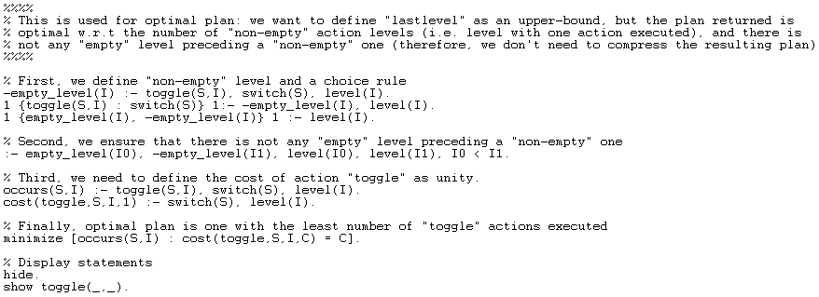
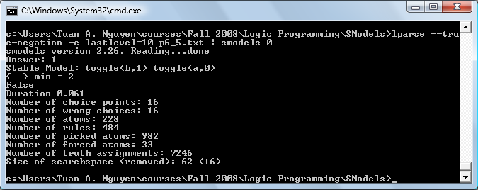
Optimal Cost Planning (cont.)
Action cost
Minimize statement

Slide 5
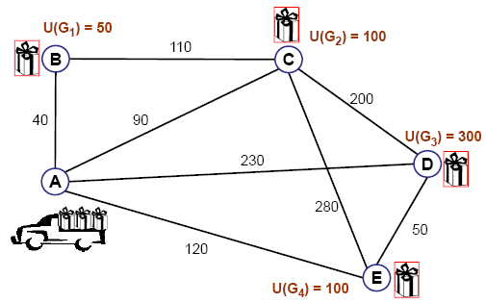
Partial Satisfaction Planning (PSP)‏
PSP problem
  Actions have cost
  Goals have reward. Not all can/need to be achieved.
  Optimal plan has maximal net-benefit.
    Net-benefit = total rewards – total action costs.
Optimal plan: {move(A,C), move(C,D), move(D,E)}
Net-benefit = (100 + 300 + 100) – (90 + 200 + 50) = 160
(Source: Anytime Heuristic Search for Partial Satisfaction Planning. J. Benton, Minh Do, Subbarao Kambhampati. AIJ-08. To appear.)‏

Slide 6
Partial Satisfaction Planning (PSP) cont.
How to encode in ASP:
  Example: extending exercise 6.5
  3 devices: d1, d2, d3.
  3 switches: a controls d1, b controls d2, c controls d3
  Action costs:
    toggle(a), toggle(b) have cost 1.
    toggle(c) has cost 5.
  Rewards:
    If a device is on, we get 0 reward.
    Otherwise, turning on d1 or d2 gives 2 reward, and 4 for d3.
  Initial state: all devices are on. No goal condition!

Slide 7
Partial Satisfaction Planning (PSP) cont.
Optimal plan:
  Turn off d1, d2: each gives 2 reward, incurs 1 cost.
    And never turn them on! (gives no reward, incurs 1 cost)‏
  Never turn d3 off. (high reward, but higher cost)‏
[0]
[2]
[2]
d1
d1
d1
[0]
[0]
[2]
d2
Turn off d1
Cost: 1
d2
Turn off d2
Cost: 1
d2
[0]
[0]
[0]
d3
d3
d3
Net-benefit = 0
Net-benefit = 1
Net-benefit = 2

Slide 8
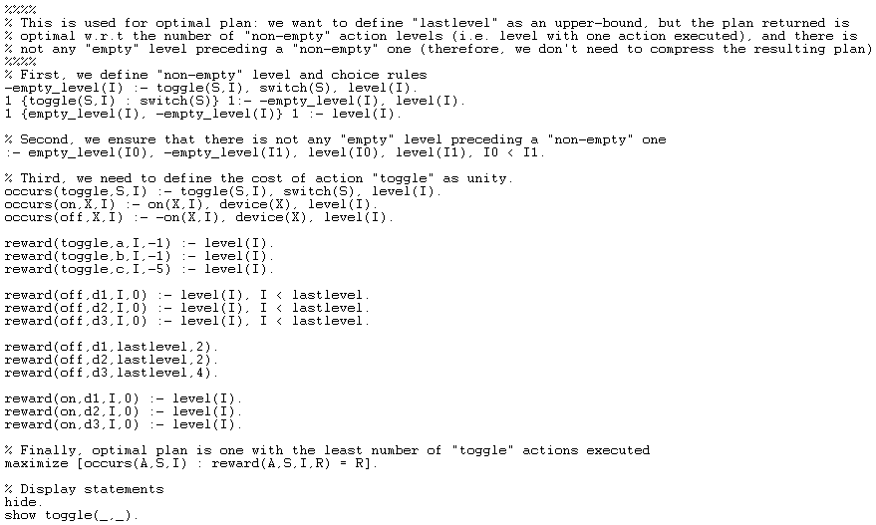
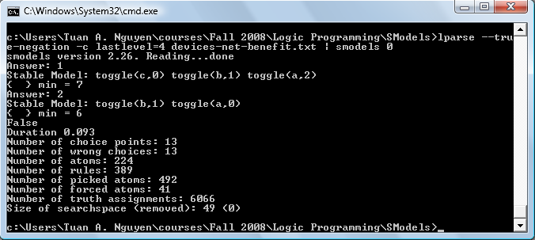
Partial Satisfaction Planning (PSP) cont.
ASP-based encoding (excerpt)‏
Action costs as negative rewards.
Rewards for off status in last level.
Rewards for on status.
Maximize statement

Slide 9
My Next Step
Prove that the optimal stable model (i.e. one with the maximal weights) corresponds to the optimal net-benefit plan.

Slide 10
Thank you
Q & A

